Slide 1
HCI Georgia

Slide 2

HUMAN CAPITAL INDEX &
HEALTH
Improving adult survival rate by reducing causes of premature mortality links to SDG target 3.4
Stunting links to SDG target 2.2
Proportion of children under 5 years of age who are developmentally on track in health, learning and psychosocial well-being, by sex SDG target 4.2.1
SURVIVAL
Under-5 mortality links to SDG target 3.2
The components of the Human Capital Index have close links with the SDGs
2
2

Slide 3
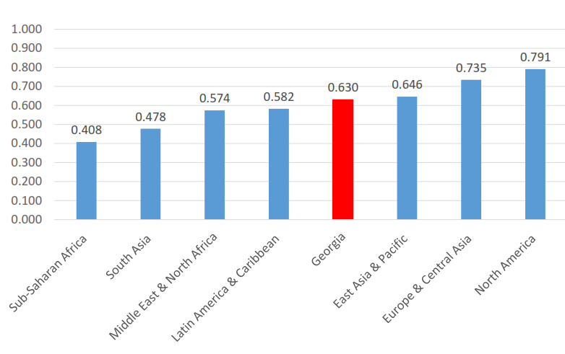
Human Capital Index

Slide 4
Preliminary Estimates of Georgia’s Human Capital Index and its Components
Indicator | Most recent estimation |  |  | Source
 | Total | Male | Female
HCI Component 1: Survival
Probability of Survival to Age 5 | 0.989 | 0.988 | 0.991 | 2016, UN Interagency Group for Child Mortality
HCI Component 2: School
Expected Years of School | 12.4 |  |  | WB staff calculations
Harmonized Test Scores | 445 | 435 | 456 | 2015, Update of Altinok, Angrist and Patrinos (2018)
HCI Component 3: Health
Survival Rate from Age 15-60 | 0.852 | 0.779 | 0.923 | 2017, UN Population Division, Interpolated
Fraction of Children Under 5 Not Stunted | 0.887 |  |  | 2009, UNICEF-WHO-WB Joint Malnutrition Estimates
Human Capital Index (HCI) | 0.630 |  |  | WB staff calculations

Slide 5
objectives
To invest for human capital development for improving health and wellbeing of societies and economics

Slide 6
Challenges (Health)
Low public spending on health (3% of GDP)
High out-of-pocket payments for healthcare
Service delivery model is biased towards hospital/emergency services, and less primary care centered
Weak health administrative data systems

Slide 7
Commitments (Health)
Increase public expenditure on health for improving health of society
Improve Primary Health Care system to promote health and wealth of population and not only treatment
Implementing a electronic medical record system as a part of e-health across the country to enhance efficiency in healthcare provision

Slide 8
Challenges (Labour)
Skills mismatch on labour market
Commitments
Skills anticipation and matching system in place and operational.

Slide 9
Challenges (Social Protection)
High number of employable population are TSA recipients are not contributing to countries economy.
Commitments
Schemes of economic activation of TSA recipient employable population are introdused.

